Slide 1
ERTS Final Assessment – Task 1
Kalyan Sudra, Khush Shah, Ronaldo Balram, Qijia Tang

Slide 2
Guidance for this presentation
This presentation is assessed and will form your mark for the first task
Keep explanations concise, use screenshots or bullet points to present information
You will have 5 minutes to present this, this is a strict limit and you will be timed
Use the time as you feel appropriate
Use your code and robot to help you present what you have done
You will also be asked questions after your presentation
Delete this slide

Slide 3
Practical elements
Show that the robot can move around effectively in both modes of operations
Show that you have made use of the LED & Switches
Is there nay difference in operation when you robot works in polling mode and interrupt mode?

Slide 4
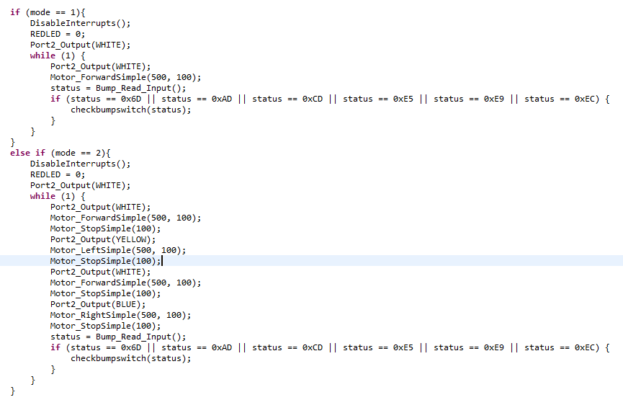
Interrupts
How do you implement operation of robot with polling? Why?
Because it is simpler to implement it

Slide 5
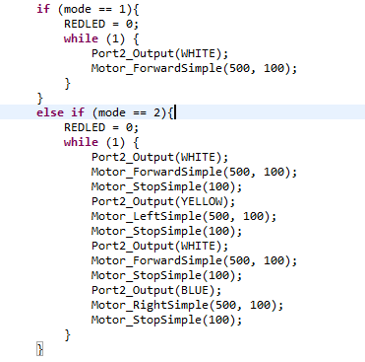
Interrupts
How do you implement operation of robot with interrupts? Why?
It saves process cycles compared to polling so it’s more efficient.

Slide 6
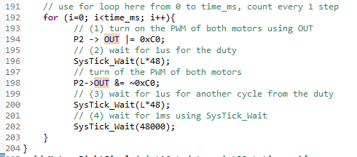
Delays
Where have delays been used? Why?
We are waiting for the duty cycle hence the need for delays.

Slide 7
CPU Usage
How have you measured the CPU utilization?
Interruption Computation time in cycles
147667075
164883882
182100689
182100696
164883893
147667096
Period of the Interruption(T)
CPU Utilization = (C/(48,000,000*T)) *100%

